Slide 1



Twitter US Airline Sentiment
Baijun, Kewei, Kuan-chen, Lingxi, Vivekanand, Yimei

Slide 2






Background
Data Source: Kaggle
Twitter data was scraped from February 16 to 24 of 2015
Airlines: American, Delta, Southwest, United, US Airways, Virgin America

Slide 3
Data Structure
Tweet_id
Airline_sentiment
Airline_sentiment_confidence
Negativereason
Negativereason_confidence
Airline
Airline_sentiment_gold
Name
Negativereason_gold
Retweet_count
Text
Tweet_coord
Tweet_created
Tweet_location
User_timezone
15 Variables
8 Variables were used

Slide 4
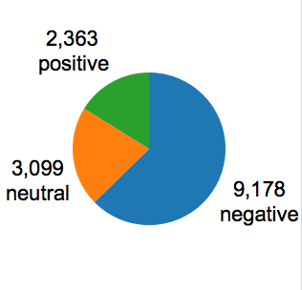
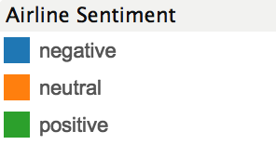
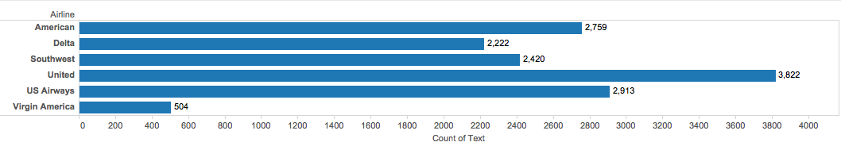
Overall Count of Tweets
Total Tweets: 14,640

Slide 5

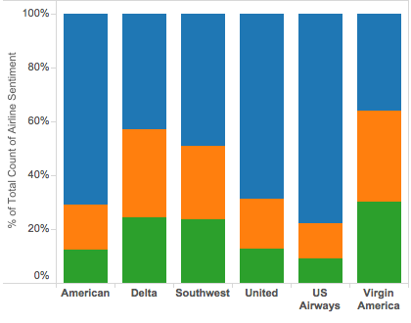


Proportion of Tweet sentiment by Airline
US Airways
Virgin America
Virgin America

Slide 6
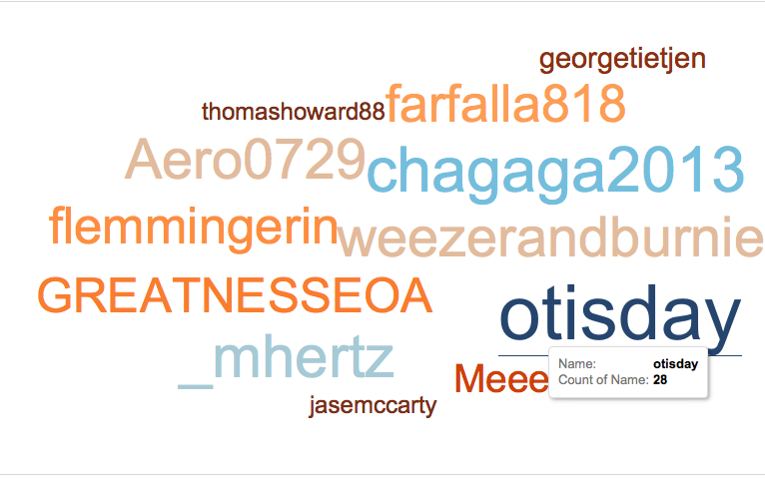
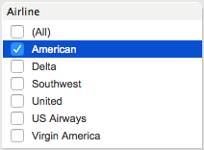
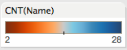
Who is complaining more for each Airline?

Slide 7
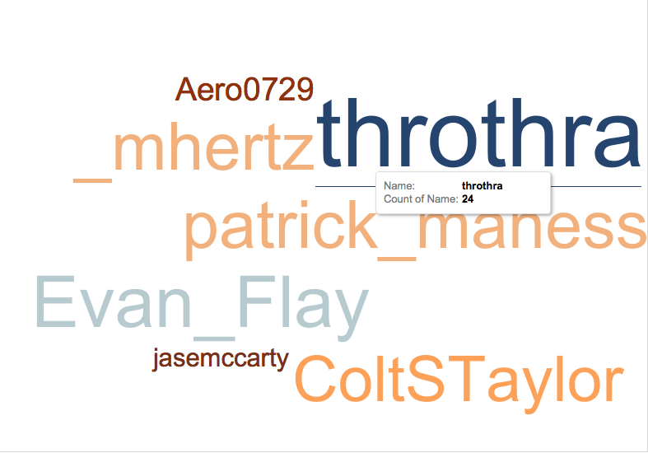
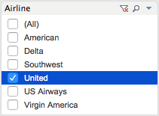
Who is complaining more for each Airline?

Slide 8
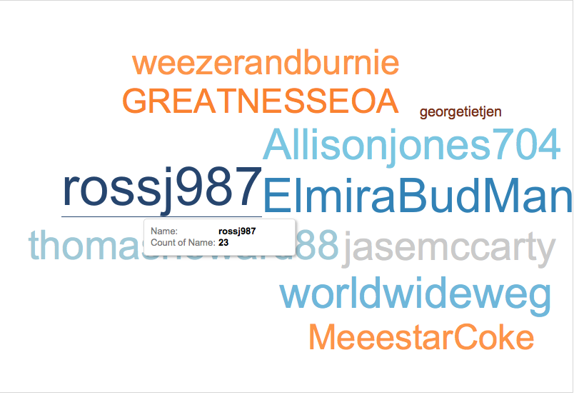
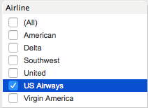
Who is complaining more for each Airline?

Slide 9
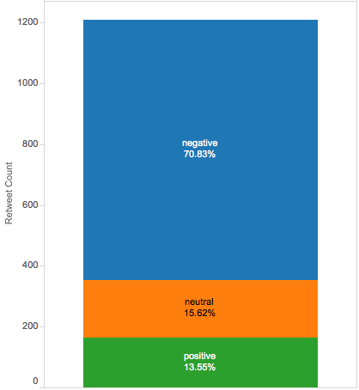
What do people retweet more often?
People tend to retweet negative tweets more often
Retweets of negative tweets are nearly 5 times as high as retweets of neutral tweets or positive tweets

Slide 10
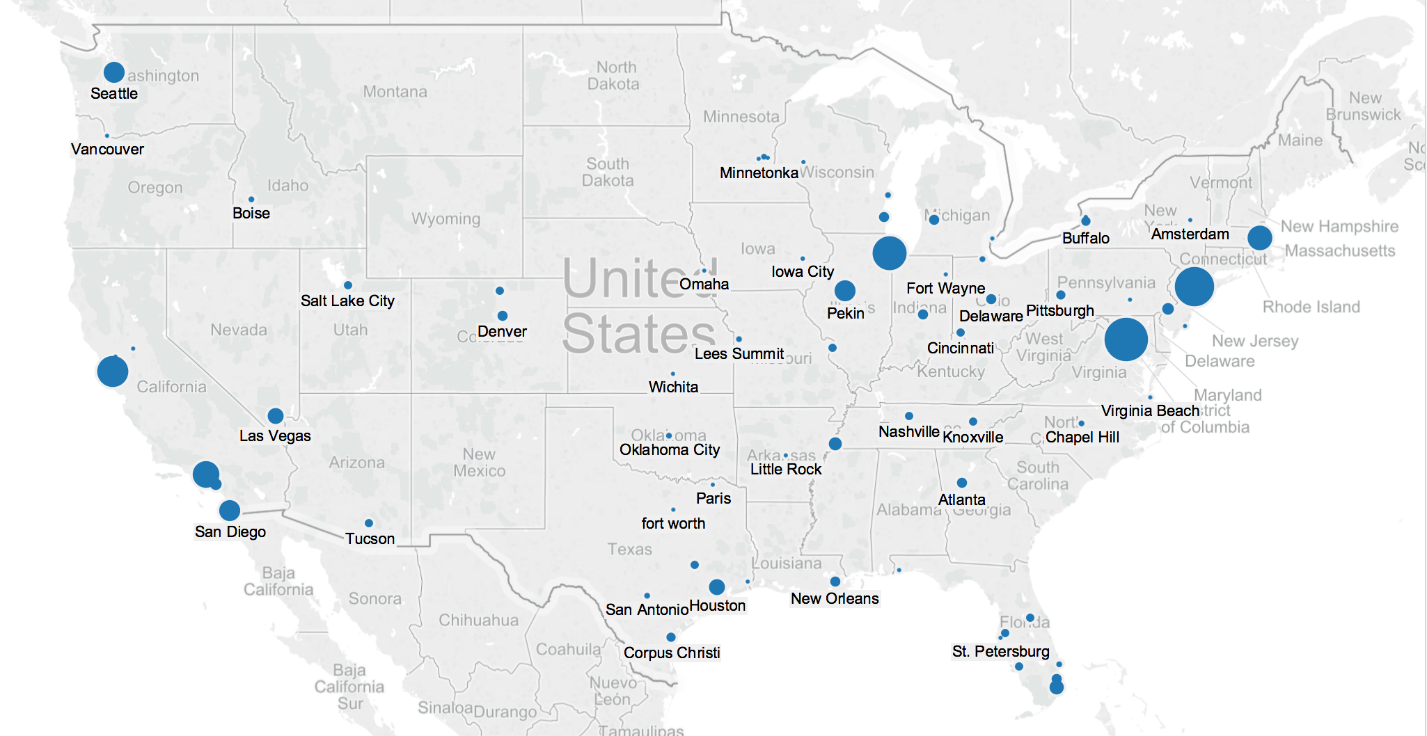



Where do most negative tweets come from?
Midwest:
Chicago
West Coast:
San Francisco
Los Angeles
San Diego
Las Vegas
East Coast:
Boston
New York
Washington
Notes:
From the map, we can see that most negative tweets come from big cities in mainly three parts of the US.
They come from east coast cities like Boston, New York and Washington and also from west coast cities such as san francisco, los angeles san diego and las vegas. There are also some negative tweets come from mid west like Chicago.

Slide 11
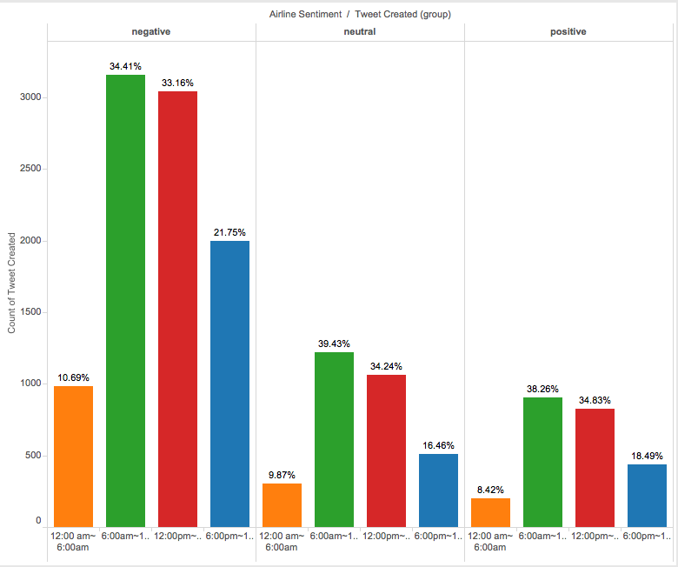

When do people tweet?
According to the chart:
People tweet most in the morning between 6:00 am to 12:00 pm
About 67.57% of the total tweets is published from 6:00 am to 6:00 pm.
Airline companies should monitor the tweets during this time period in order to build its social image
Notes:
According to the chart, we can see that people tweet most in the morning between 6:00 am to 12:00 pm. Check this green section in the positive, negative and natural tweets.
About 69.84% of the total tweets is published from 6:00 am to 6:00 pm. Airline companies should monitor the tweets during this time period in order to build its social image

Slide 12
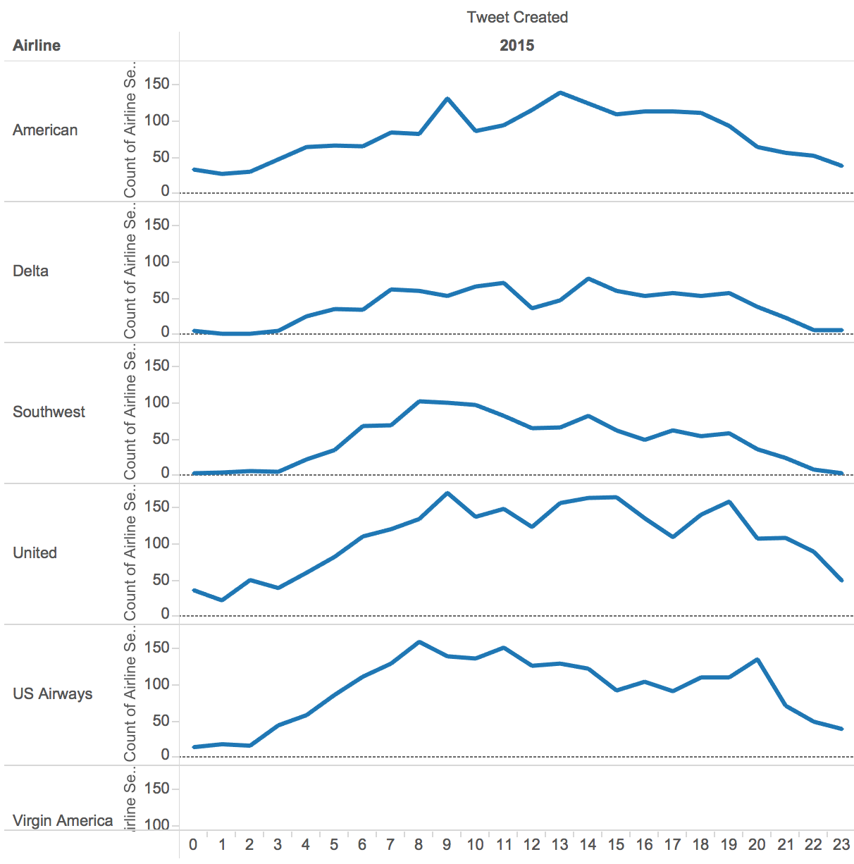
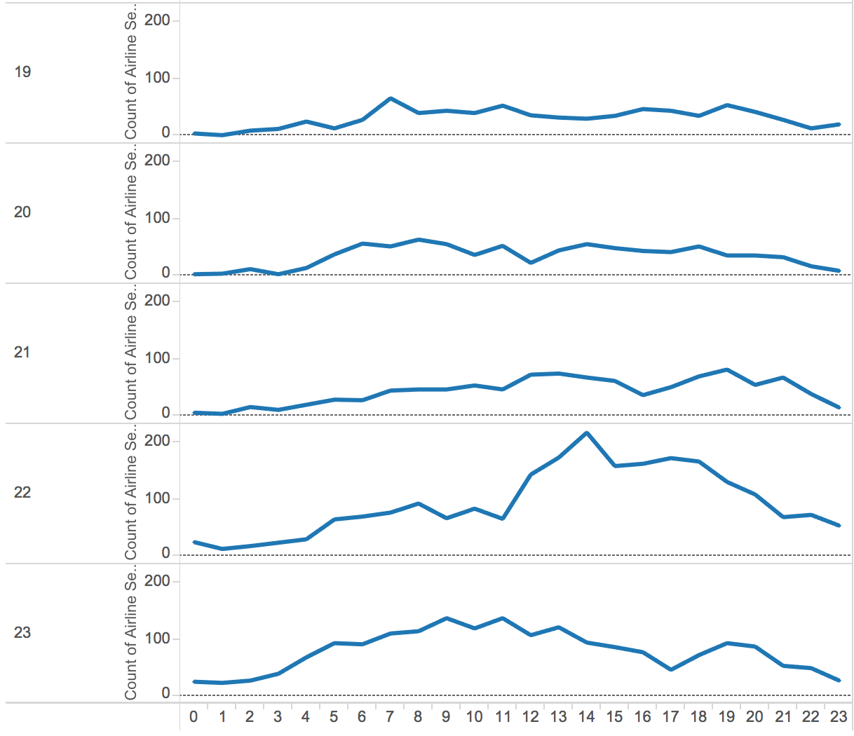

When do people tweet negatively?
Notes:
From the graph on the left, the X-axis shows the time while the y axis shows different airlines. We can see that most people tweets negatively from 8am to 4 pm. Most flights are ranged between 8-4 or are delayed or canceled during this period of time.. From the graph on the right, the x axis still shows the time while the y axis shows the date. Apparently, there is a spike on February 22nd and it means that something happened and influenced the flying experience.
Now I will show you a time lapse visualization that combines both when and where about negative tweet.

Slide 13
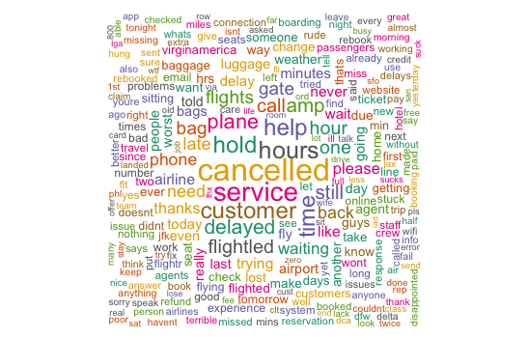
Overall Word Cloud for Negative Sentiment

Slide 14
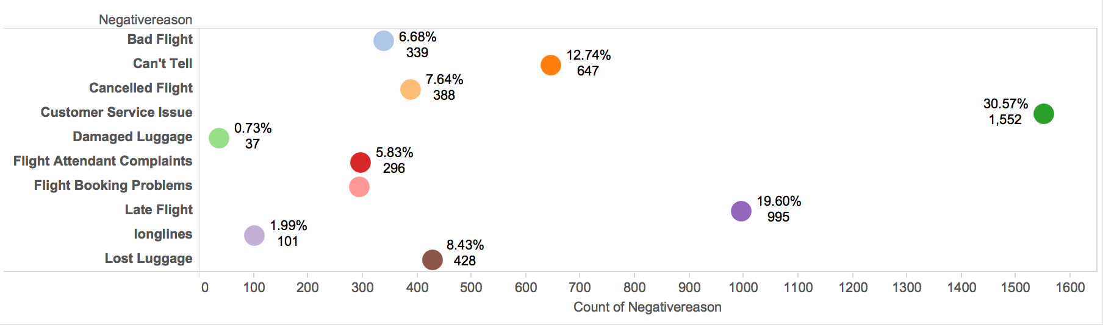
Negative Tweets by Reason

Slide 15
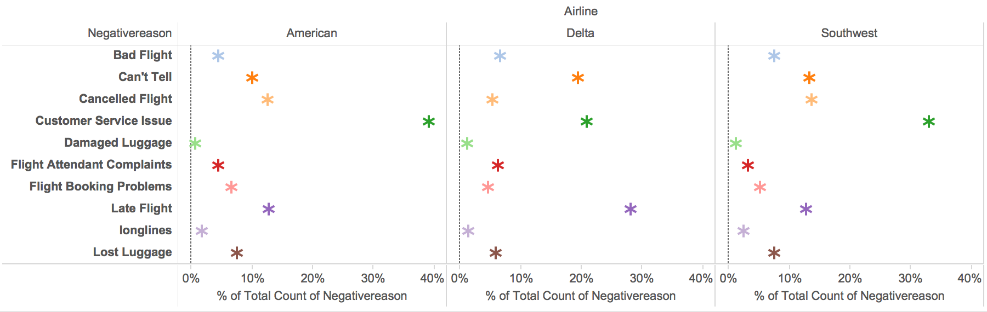
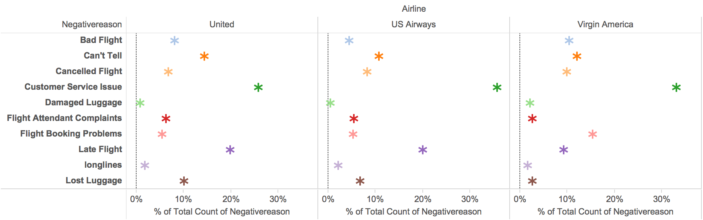

Slide 16
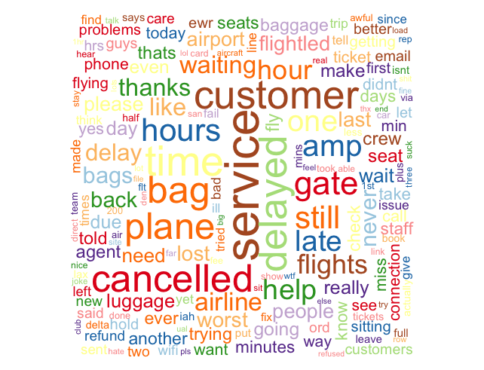
UNITED AIRLINES
Notes:
united

Slide 17
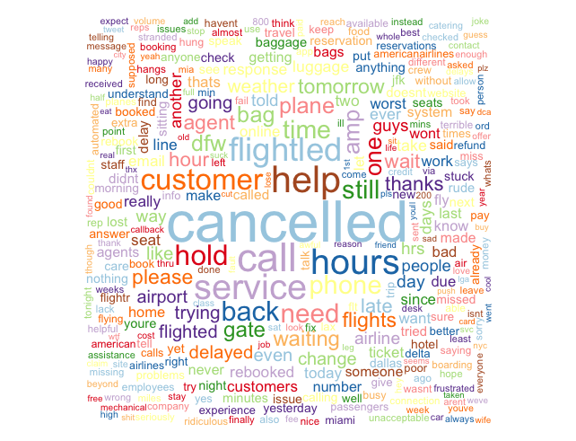
AMERICAN
AIRLINES

Slide 18
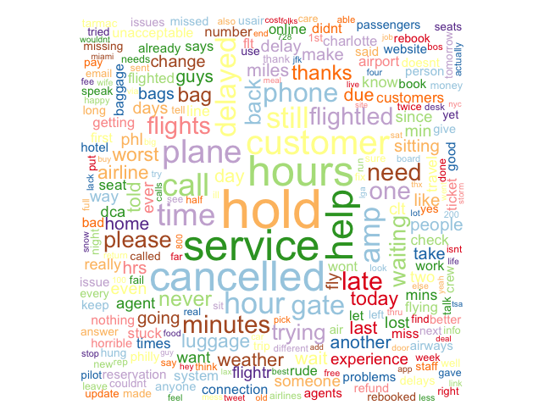
US AIRWAYS

Slide 19
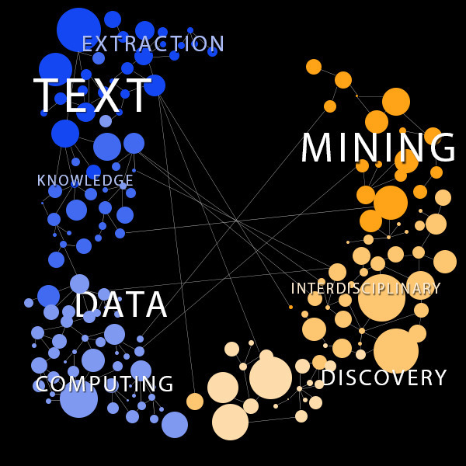
Text Mining
Process of deriving high-quality information from text
Based on principles of Information Retrieval theory
Library tm in R

Slide 20
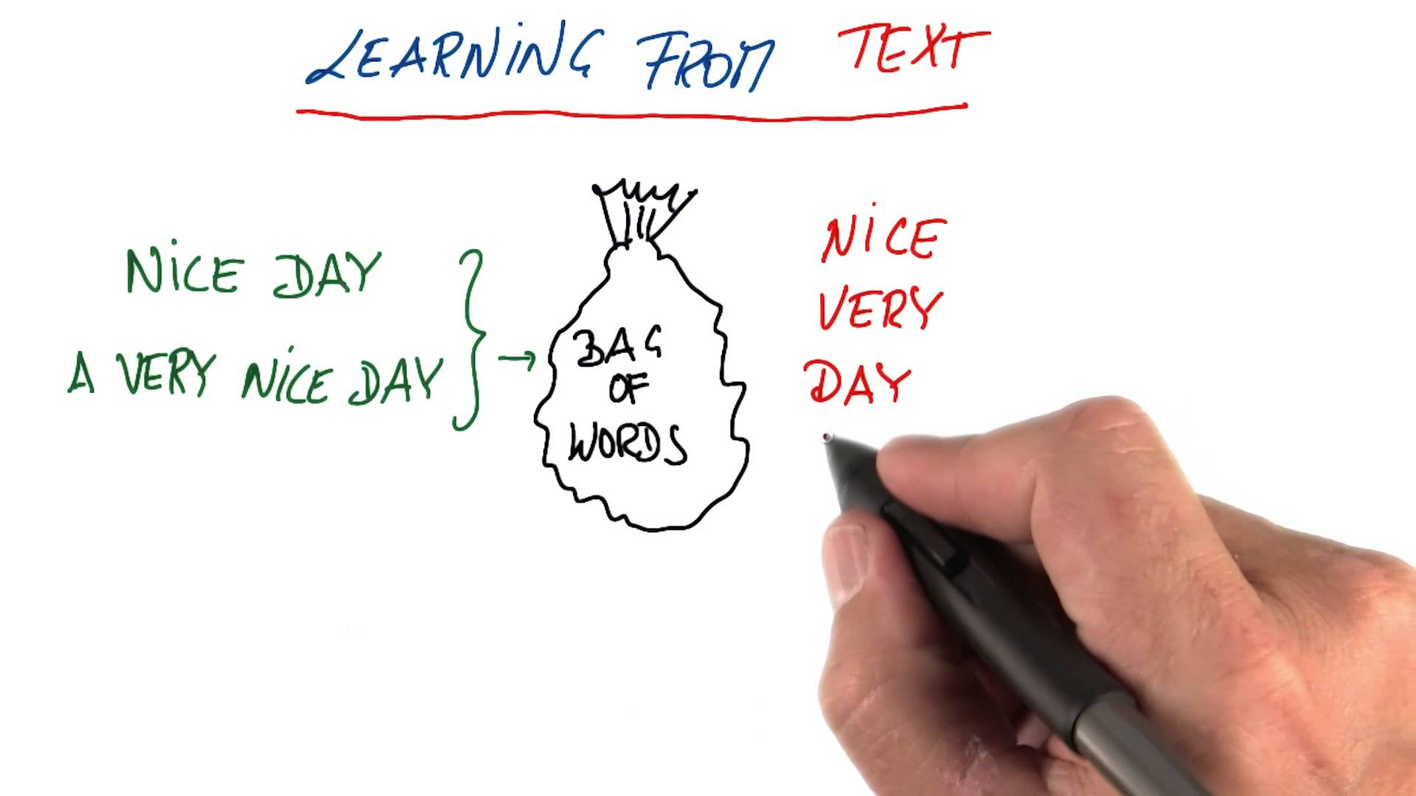
Features and models tried
Text mining features
Bag-of-words - Unigrams
Bigrams
TF-IDF weighting
Models
Naive Baye’s classifier
CART

Slide 21
Results - Airline sentiment
Features | Weighting | Model | Accuracy | Recall | True Neg. rate | Precision | F-Measure
Unigrams | No TF-IDF | Naïve Baye's | 18.76% | 5.40% | 40.92% | 13.17% | 0.077
Unigrams | No TF-IDF | CART | 69.85% | 90.65% | 30.80% | 71.10% | 0.797
Unigrams | TF-IDF | CART | 69.95% | 90.47% | 31.86% | 71.13% | 0.796
Bigrams | No TF-IDF | CART | 71.86% | 89.88% | 37.40% | 73.30% | 0.807
Unigrams & Bigrams | No TF-IDF | CART | 73.00% | 91.21% | 35.43% | 74.45% | 0.820
Unigrams & Bigrams | TF-IDF | CART | 73.68% | 90.30% | 38.96% | 75.55% | 0.823

Slide 22
Results - Negative Reason - Accuracy - 55.85%
Cust1 | Bad Flight | Can't Tell | Cancelled Flight | Customer Service Issue | Damaged Luggage | Flight Attendant Complaints | Flight Booking Problems | Late Flight | longlines | Lost Luggage
Bad Flight | 33 | 7 | 1 | 11 | 1 | 5 | 1 | 9 | 1 | 2
Can't Tell | 29 | 136 | 19 | 110 | 1 | 34 | 29 | 46 | 12 | 21
Cancelled Flight | 0 | 2 | 74 | 16 | 0 | 1 | 10 | 5 | 0 | 2
Customer Service Issue | 6 | 10 | 5 | 239 | 1 | 4 | 8 | 14 | 7 | 6
Damaged Luggage | 0 | 0 | 0 | 0 | 0 | 0 | 0 | 0 | 0 | 0
Flight Attendant Complaints | 1 | 2 | 0 | 3 | 0 | 18 | 0 | 3 | 1 | 0
Flight Booking Problems | 1 | 4 | 5 | 12 | 1 | 0 | 21 | 3 | 0 | 0
Late Flight | 12 | 10 | 4 | 30 | 1 | 7 | 14 | 170 | 9 | 9
longlines | 0 | 0 | 0 | 0 | 0 | 0 | 0 | 0 | 0 | 0
Lost Luggage | 3 | 4 | 1 | 6 | 5 | 5 | 1 | 9 | 6 | 78

Slide 23

Tweets extraction
Tool: “TwitteR” package in R
About what: @American, @US Airways, @United, @Delta, @Southwest, and @Virgin America.
Extracted total 1200 tweets
Quantity: 200 each
Language: English
When: Recent
“New” dataset + “old” dataset = “total” dataset

Slide 24
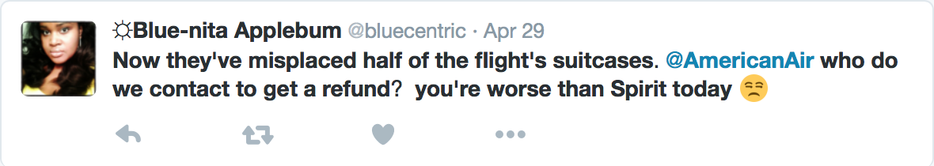

Text cleaning
Change all words to lowercase.
Remove all punctuations.
Remove meaningless words such as “get”, “now”, “they”, “who”, etc.
Remove emoji.
Remove white space.
now they’ve misplaced half of the flight’s suitcases. @americanair who do we contact to get a refund? you’re worse than spirit today
now they ve misplaced half of the flight s suitcases americanair who do we contact to get a refund you re worse than spirit today
misplaced suitcases americanair we contact refund worse spirit
misplaced flight suitcases americanair we contact refund worse spirit

Slide 25
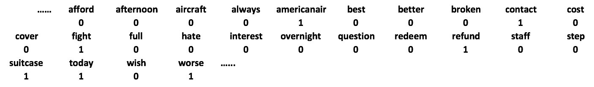
Text cleaning
Notes:
Document term matrix

Slide 26
Model application
“Old” dataset
“Total” dataset
CART
“New” dataset
Notes:
Separate “total” dataset to two dataset based on whether the tweet is new or not.
Use “new” dataset as training dataset and “old” dataset as testing dataset
Run CART on training dataset and use the model to predict the sentiment on the testing dataset.

Slide 27
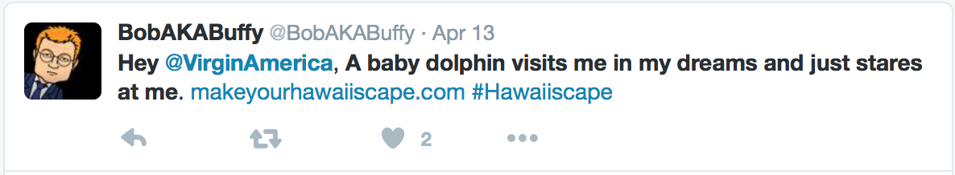
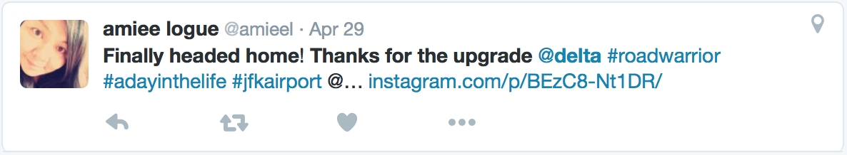
Sentiment prediction
Positive
Negative
Neutral
Positive

Slide 28

Thank you!

